Slide 1
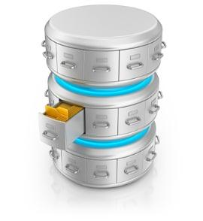



DATABASE DESIGN LAB
If you haven’t already accessed in the last session!
VMware Fusion
VMware Fusion
Open from the application menu.
Open Finder from the application menu.
Under the Go menu at the top select Go to Folder
In the box type the path /var/slis/Win7
Double click the VMware Icon
Click I copied it when prompted
Select the Slis user icon
Enter password is slizzard! when prompted
If you did access it last session, use only steps 5-8 to access it now.

Slide 2

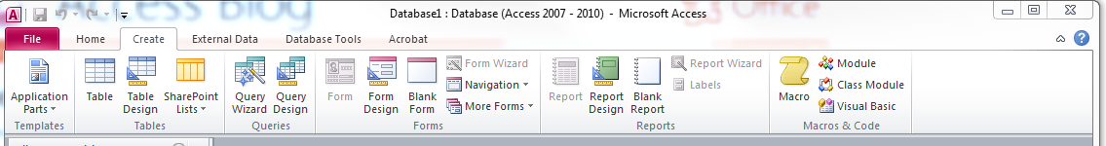
DATABASE DESIGN LAB
Session 2
Microsoft Access: What are Query, Form & Report
Table Tools
Query Tools
Form Tools
Report Tools

Slide 3
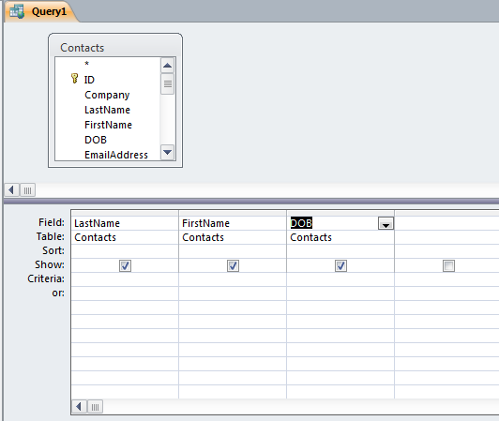
DATABASE DESIGN LAB
Session 2
Microsoft Access: Query
Fundamental part of developing a database
How you ask questions of your data
Customizable Filter
In Access queries can be saved ☺
In Access option of visual display of the query.☺

Slide 4
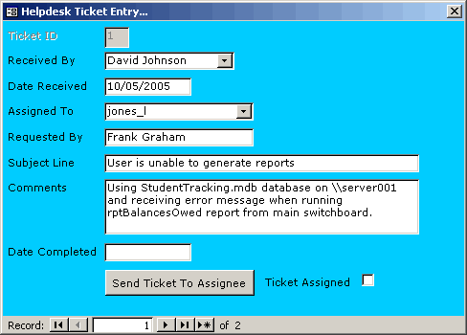
DATABASE DESIGN LAB
Session 2
Microsoft Access: Form
Database object that controls access to your data.
What can be seen of your data
What can be entered into your data
Provides a user friendly interface.
Customizable look
Forms can be saved

Slide 5
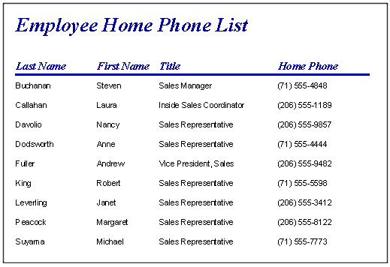
DATABASE DESIGN LAB
Session 2
Microsoft Access: Reports
Fast way to create a professional looking report from your data.
Report results are a finished product appropriate for printing
Customizable format including, headers, footers, colors, style, etc.
Can be run from a query
Allows for filtering, sorting or grouping of data
Can be saved and reused in whole or part.

Slide 6
DATABASE DESIGN LAB
Session 2
Online tutorials at Lynda.com for more help in using Access.
https://ittraining.iu.edu/lynda/
Open the exercise file in the lab section for session 2
on the course website:
http://info.slis.indiana.edu/~dingying/S511Spring2013.html

